Slide 1
Peer PULSE
Creating an all-in-one platform for students, offering resources
like Living Housing, Events, Blogs, for member interactions

Slide 2
Tech STack

Slide 3









Slide 4
Team Members
Raveena Ravindra Ingale
Hari Sriya Pelluri
Kavya Rachana Malluvalasa
Sai Krishna Reddy Gaddam

Slide 5
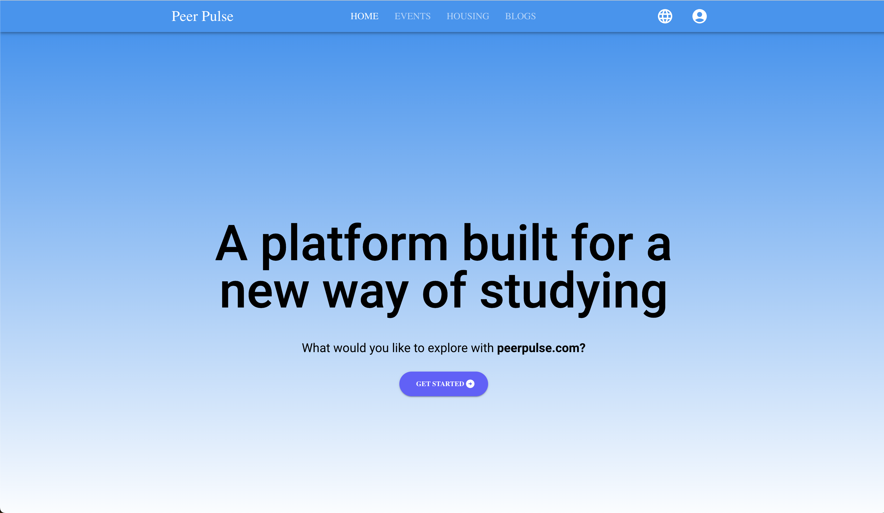
Landing Page of Peerpulse

Slide 6
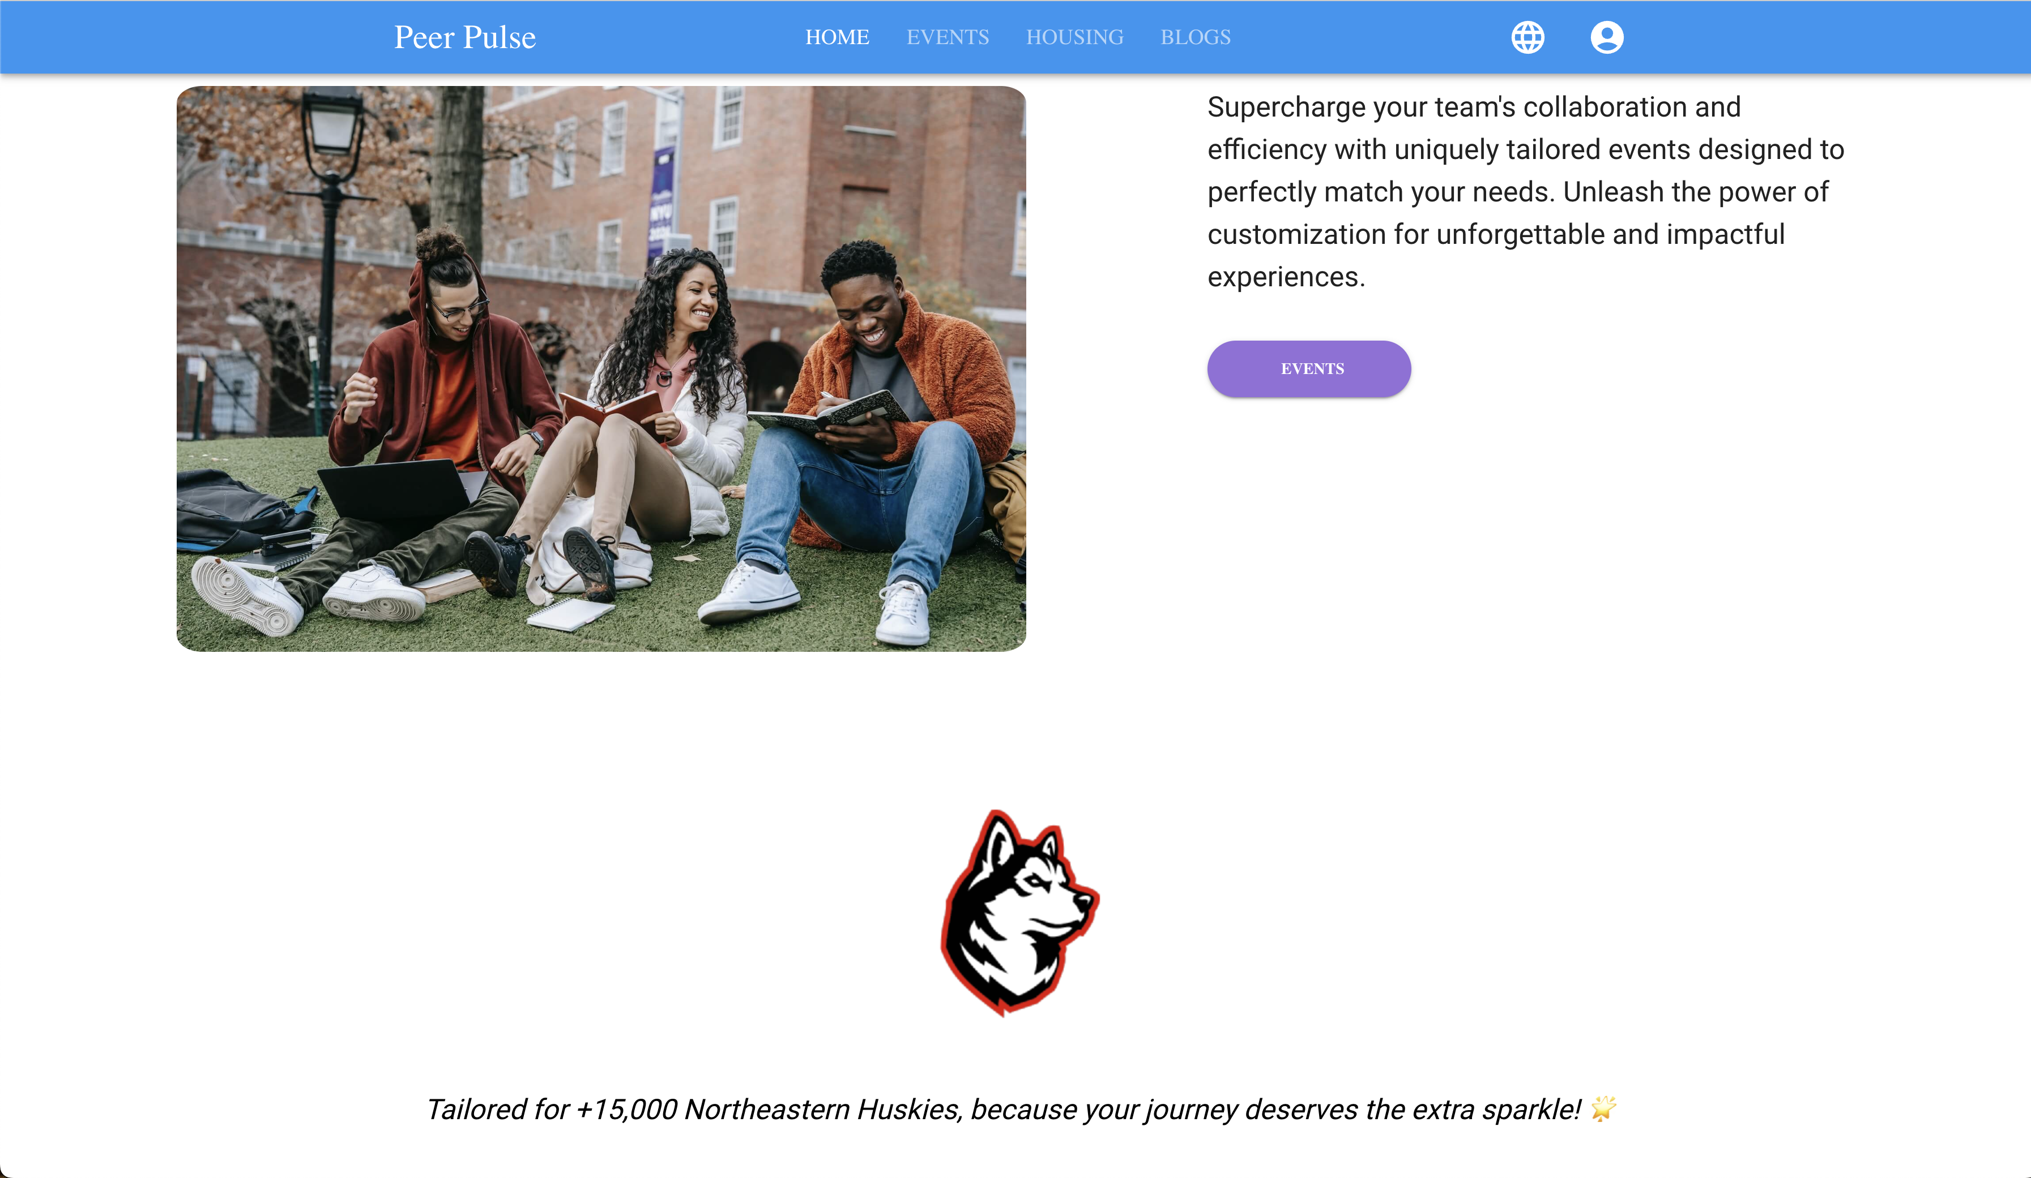

Slide 7

Blogs Page

